Slide 1

HYPERTENSION: SILENT DESTROYER
VARSHA SANE: EUID: vs1625
SAI SHIVANI PARIMI: EUID: sp3403
SUNITHA BYRAPAKA: EUID: sb3073
RIA SINGH: EUID: rs1711

Slide 2
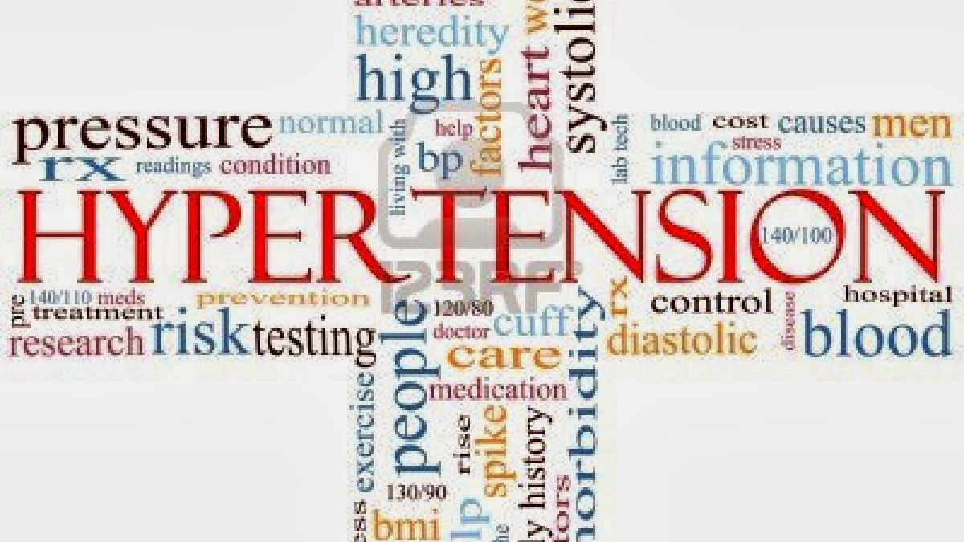
Topic Outline
Introduction
Research Questions
Results
Conclusion & Discussion
This Photo by Unknown Author is licensed under CC BY-NC-ND

Slide 3

Introduction
Hypertension is a widespread illness that is becoming more and more prevalent. Based on data from the World Health Organization, the total number of adults globally with hypertension has doubled since 1990, to 1.28 billion.
The average systolic blood pressure was 127.0 mmHg for males and 122.3 mmHg for women, according to studies by Mills, K. T. (2016) and Zhou, B. (2015), while the normal diastolic BP was 78.7 mmHg for men and 76.7 mmHg for women. The American College of Cardiology–American Heart Association (ACC–AHA) Hypertension Guideline implemented a newer range in 2017, the systolic blood pressure and diastolic blood pressure shouldn't be more than 130mm Hg and 80 mm Hg respectively (Whelton PK et al., 2017). Although, in past years hypertension was defined with the blood pressure value of 140/90 mm Hg or more. Higher blood pressure was more prevalent in South Asia, Africa, and Central and Eastern Europe.

Slide 4
Hypertension: A Silent Killer Understanding Its Prevalence and Impact
Hypertension: A Silent Killer
Understanding Its Prevalence and Impact
Global Burden: Over 1.28 billion people worldwide are affected by hypertension, with nearly half unaware of their condition.
Silent Symptoms: Hypertension shows no clear symptoms but leads to life-threatening conditions such as stroke, heart failure, and kidney disease.
Underdiagnosis & Treatment Gap: Only 42% of hypertensive individuals are diagnosed and treated, contributing to high morbidity and mortality rates.

Slide 5

Risk and Influential Factors
Hypertension is a highly prevalent disease whose incidence sharply increases as people get older. (Buford, T. W. 2016)
With regard to the modifiable conditions, obesity accounted for 38.2% of the weighted PAR%, whereas poor physical activity and sedentary behavior together were responsible for 3.1% (Hou & Yang,2024).
In developed nations, those who have a family history of hypertension have been estimated to have a danger of developing high blood pressure up to four times higher than compared to the average person. (Sande et al.,2001)
Cardiovascular disease (CVD) is the primary contributor to preventable illness which accounts for 7.1 million annual deaths. Smoking and drinking are a significant risk factor for heart disease, consumption of these has a direct link with hypertension (Venkataraman et al., 2024).
Patients with hypertension are more likely to have obstructive sleep apnea than the local population. (Floras,2015). OSA is identified in epidemiological evidence as a prevalent and modifiable factor in the development of HTN (Konecny et al.,2014)
Socioeconomic status (SES) is a prominent risk indicator for high blood pressure (Busingye et al., 2014). Low SES is linked with higher blood pressure (Leng, B et al., 2015). High-income areas like the Western world and the Asia-Pacific region have lower blood pressure.

Slide 6

Research Questions
How does the presence of hypertension influence total healthcare expenditures, and what is the extent of its economic burden compared to individuals without hypertension?
Is there a significant relationship between hypertension and person weight and how does weight variability contribute to hypertension prevalence?
What is the association between hypertension and diabetes diagnoses, and how frequently do these conditions coexist in the studied population?
Does a diagnosis of hypertension correlate with the likelihood of coronary heart disease, and what are the implications for cardiovascular health management?

Slide 7
Data Preprocessing
Remove duplicates based on DUPERSID
Variables of our interest,
Processed missing values
Removed outliers
Removed redundancy attributes using correlation test
Performed descriptive analysis to answer our research questions

Slide 8

Variables

Slide 9
Variable Name | Description | Type
SEX | Sex | Categorical
RACETHX | Race/ethnicity (hypertension prevalence and outcomes vary across racial/ethnic groups) | Categorical
HIBPDX | Hypertension diagnosis | Categorical
HIBPAGED | Age of diagnosis for hypertension | Numerical
BPMLDX | Blood pressure measurement diagnosis | Categorical
CHDDX | Coronary heart disease diagnosis (related to hypertension complications) | Categorical
CHOLDX | Cholesterol diagnosis (monitored in hypertensive patients) | Categorical
CHOLAGED | Age of diagnosis of cholesterol issue | Numerical
STRKDX | Stroke diagnosis (hypertension is a risk factor for stroke) | Categorical
EMPST31 | Employment status in round 3 | Numerical
MNHLTH31 | Mental health status in round 3 | Categorical
ACTLIM31 | Activity limitation | Categorical
DIABDX_M18 | Diabetes diagnosis (if related to hypertension) | Categorical
MIDX | Indicator for myocardial infarction diagnosis | Categorical
OFTSMK53 | Frequency of smoking in round 5 | Categorical
OBDRV19 | Frequency of visits indicates disease management and severity. | Numerical
FAMINC19 | Family total income | Numerical
INSCOV19 | Insurance coverage indicator | Categorical
RXNUM | Prescription count | Numerical
PERWT19F | Person weight (used for BMI calculation) | Numerical
TOTTCH19 | Total healthcare expenditure (reflecting economic burden of hypertension-related conditions) | Numerical

Slide 10

Results

Slide 11

HIBPDX vs TOTTCH19: How does the hypertension influence health care expenditure

Slide 12
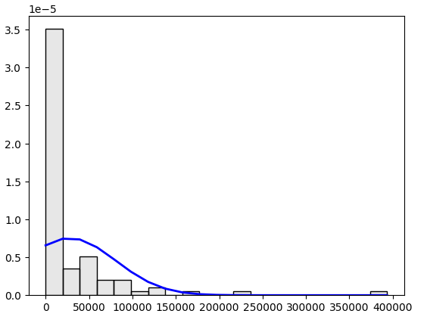
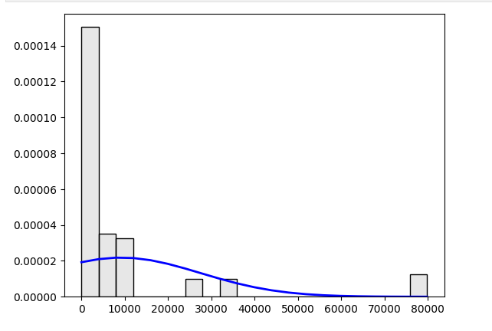
Samples without hypertension

Slide 13

MANN WHITNEY
Test Choice (Mann-Whitney Test): The Mann-Whitney test was selected because the data for both groups was found to be not normally distributed, as evidenced by:
High skewness values for both groups (4.27 and 3.06, respectively).
Excessive kurtosis values (24.17 and 9.12, respectively).
p-value: The p-value (0.0000126) is significantly smaller than the conventional significance threshold ((\alpha = 0.05)). This indicates that there is a statistically significant difference in the total healthcare expenditures (TOTTCH19) between individuals with hypertension and without hypertension.

Slide 14
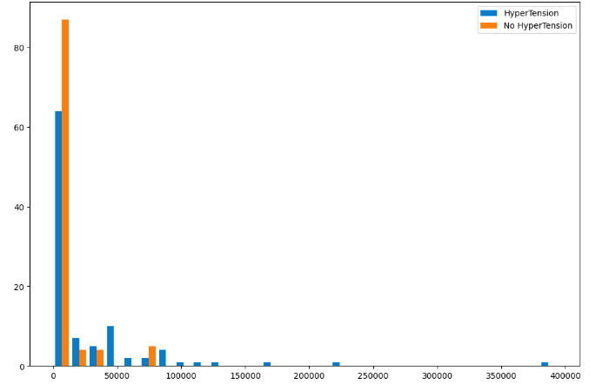

Slide 15
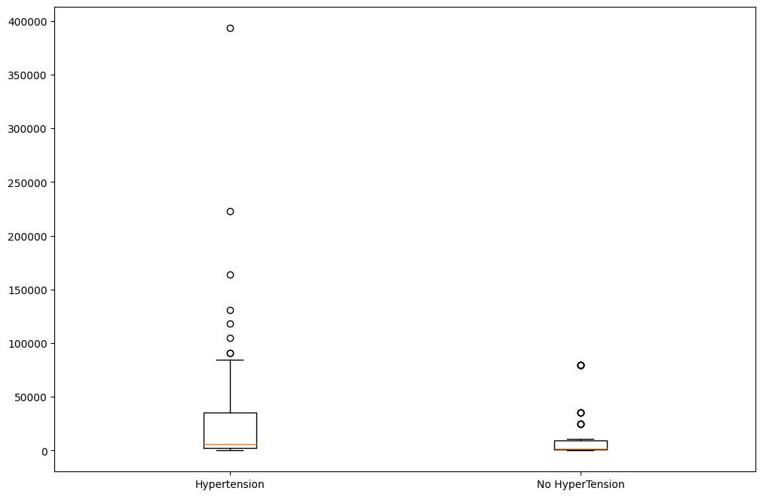

Slide 16

Interpretation of results
The Mann-Whitney U test confirms a statistically significant difference in total healthcare expenditures between individuals with hypertension and without hypertension. The significantly lower p-value underscores this conclusion, reinforcing the notion that individuals with hypertension typically face a greater financial burden due to the costs of treatment, medications, and management of related complications.

Slide 17

HIBPDX vs PERWT19F: Is there a significant relationship between hypertension & person’s weight

Slide 18
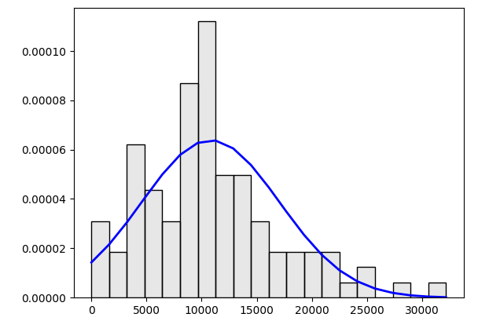
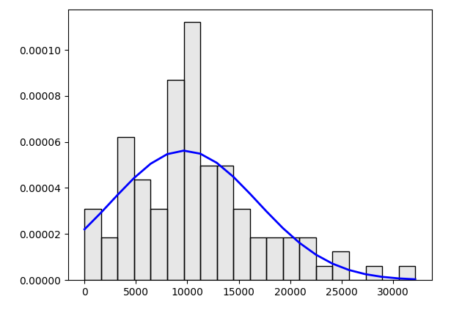
Samples without hypertension

Slide 19

MANN -WHITNEY
Test Choice (Mann-Whitney Test): The Mann-Whitney U test was selected because the data for the two groups is not normally distributed, based on earlier evidence such as:
Skewness (0.85 & 1.81) and kurtosis (0.95 & 3.75) values deviating from normality
p-value: The p-value (0.0295) is smaller than the standard significance threshold ((\alpha = 0.05)). This indicates a statistically significant difference in the distributions of the variable under consideration between the two groups (e.g., individuals with and without hypertension).

Slide 20
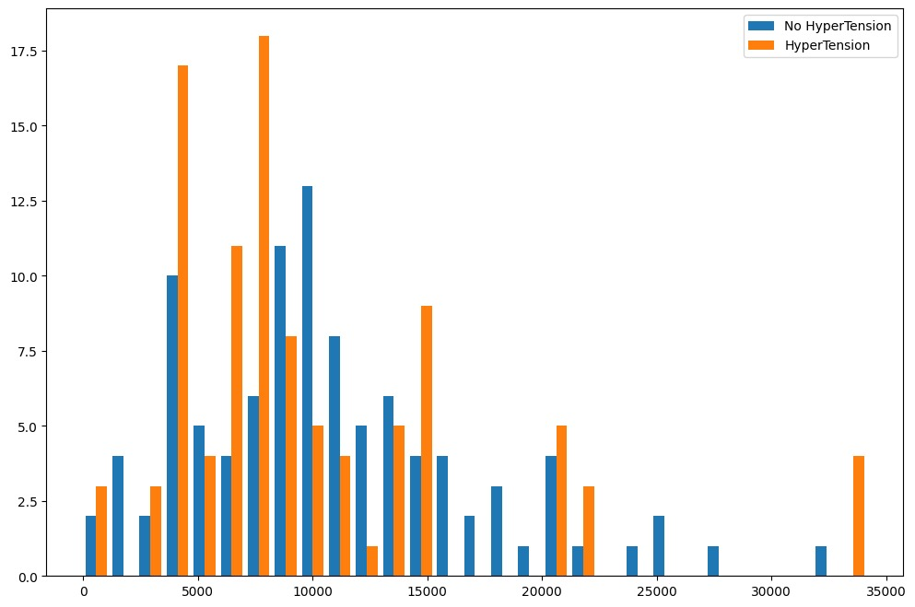

Slide 21
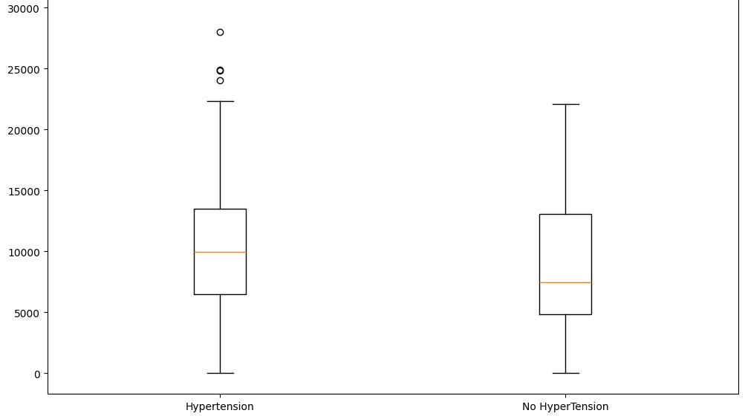

Slide 22
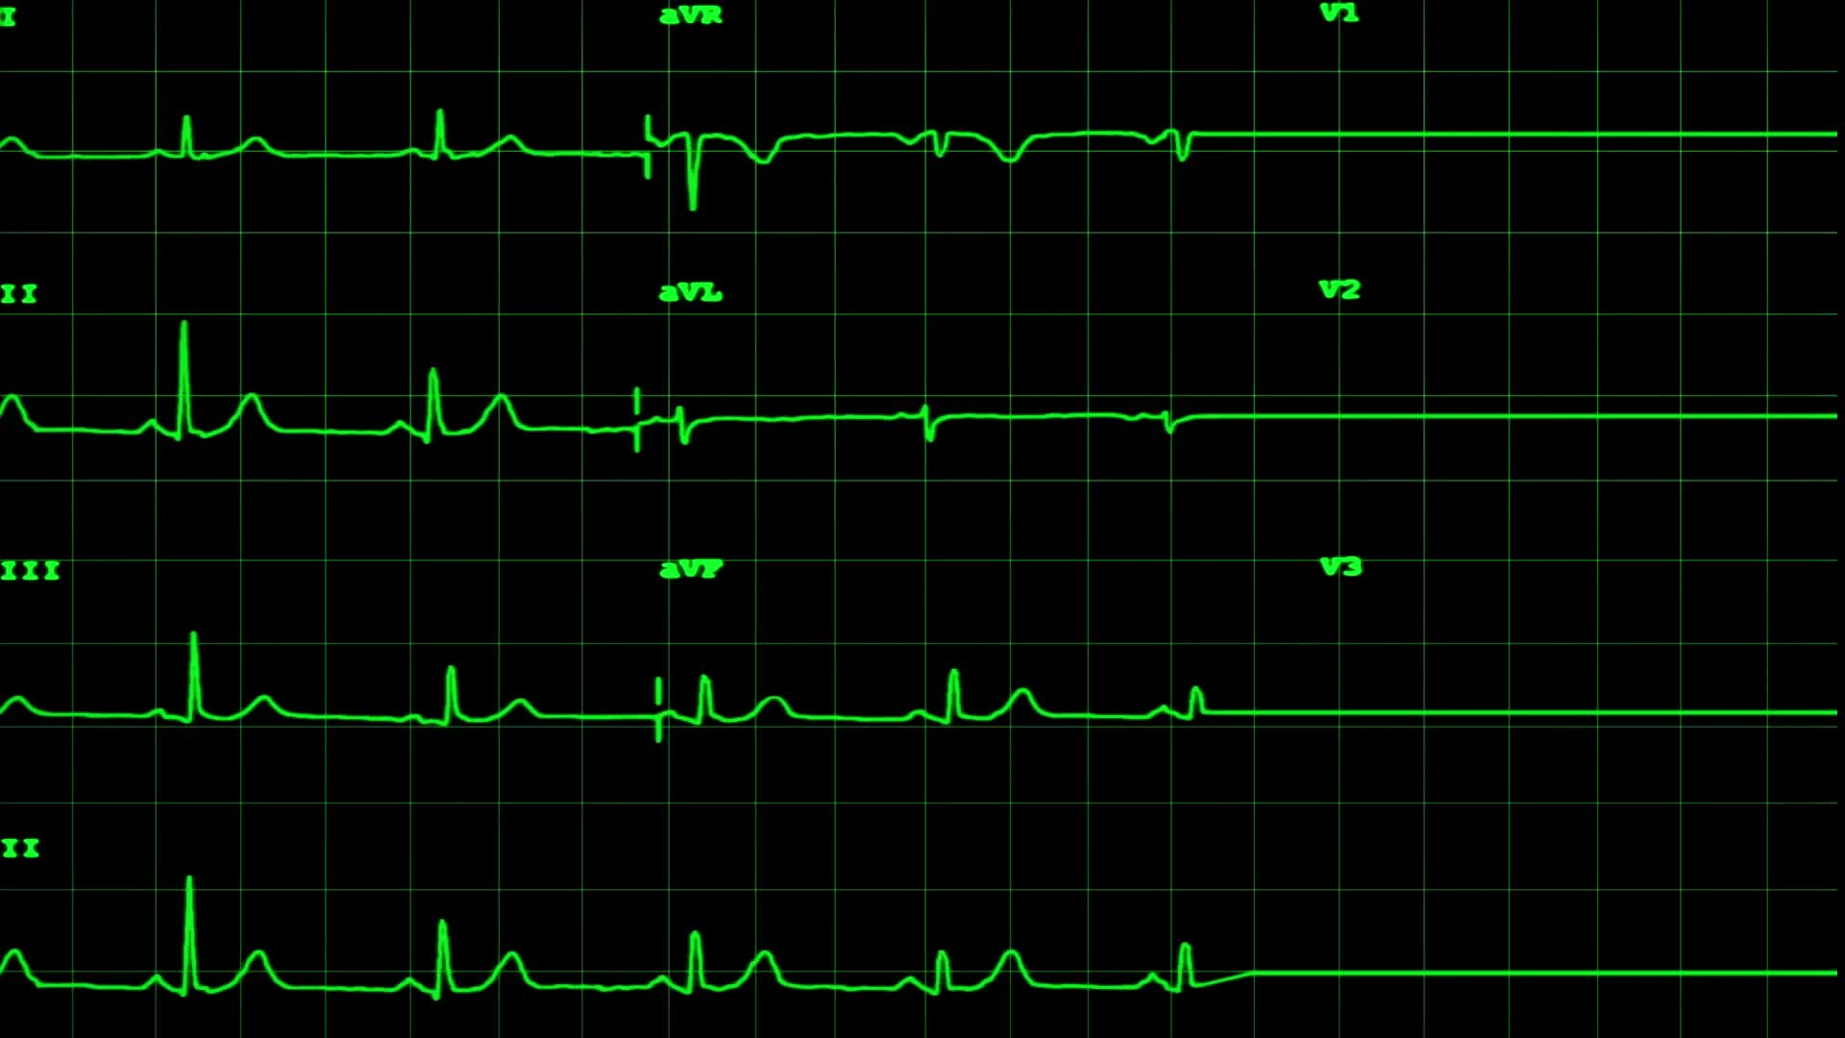
Interpretation of results
The significant result (p=0.0295p = 0.0295p=0.0295) supports the conclusion that BMI and hypertension are related. Specifically, BMI appears to differ significantly between individuals with and without hypertension, likely reflecting a higher prevalence of elevated BMI among those with hypertension.
This analysis highlights the importance of weight management as a preventive strategy for hypertension.

Slide 23

HIBPDX vs DIABDX_M18
HIBPDX vs DIABDX_M18: is there association between hypertension and diabetes
Since these two are categorical variables we used chi-square test to analyze them.
Interpretation: Since the p-value (0.00268) is much smaller than the significance level ((\alpha = 0.05)), suggests that there is a statistically significant association between hypertension and diabetes diagnoses.
Healthcare providers should consider monitoring patients with one condition for the presence of the other to improve management and outcomes

Slide 24
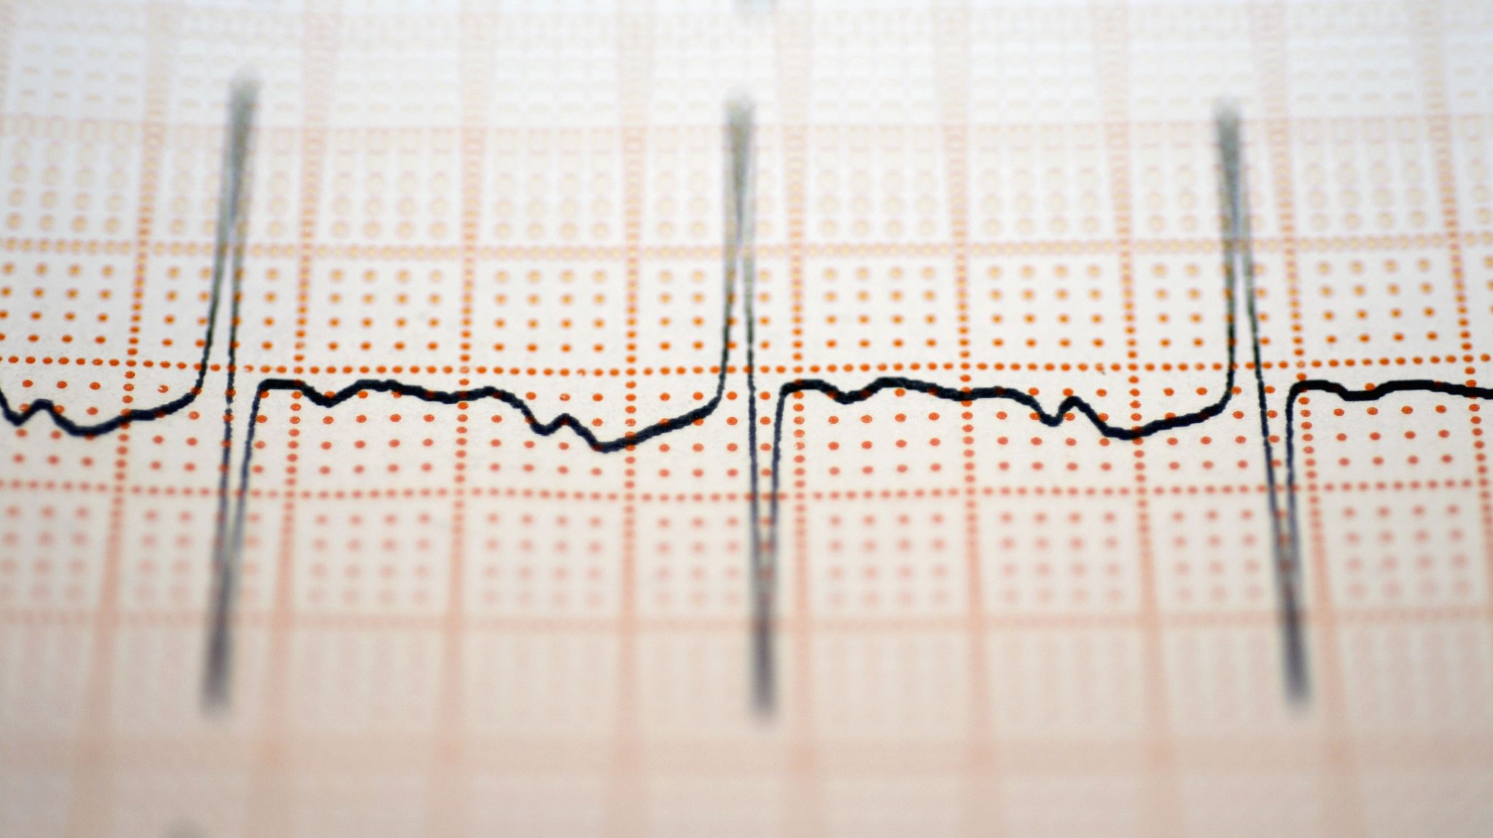
HIBPDX VS CHDDX
HIBPDX VS CHDDX: Does diagnosis of hypertension correlate with the likelihood of coronary heart diseases.
Since these two are categorical variables we used chi-square test to analyze them.
Interpretation: The p-value (0.0411) indicates a statistically significant association between hypertension and coronary heart disease. This means individuals with hypertension are more likely to have coronary heart disease (or vice versa).
Healthcare providers should monitor patients with hypertension for signs of coronary heart disease to improve early diagnosis and treatment outcomes.

Slide 25

References
Buford, T. W. (2016). Hypertension and aging. Ageing Research Reviews, 26, 96–111. https://doi.org/10.1016/j.arr.2016.01.007
Busingye, D., Arabshahi, S., Subasinghe, A. K., Evans, R. G., Riddell, M. A., & Thrift, A. G. (2014b). Do the socioeconomic and hypertension gradients in rural populations of low- and middle-income countries differ by geographical region? A systematic review and meta-analysis. International Journal of Epidemiology, 43(5), 1563–1577. https://doi.org/10.1093/ije/dyu112
Carey, R. M., Moran, A. E., & Whelton, P. K. (2022). Treatment of hypertension: a review. Jama, 328(18), 1849-1861. doi:10.1001/jama.2022.19590
Hou, Y., & Yang, S. (2024). Association of risk factors for high blood pressure across 46 low- and middle-income countries: A multi-country cross-sectional analysis. Journal of Global Health, 14. https://doi.org/10.7189/jogh.14.04087

Slide 26
References
Konecny, T., Kara, T., & Somers, V. K. (2014). Obstructive sleep apnea and hypertension: an update. Hypertension, 63(2), 203-209. https://doi.org/10.3390/jcm13175001
Leng, B., Jin, Y., Li, G., Chen, L., & Jin, N. (2015e). Socioeconomic status and hypertension. Journal of Hypertension, 33(2), 221–229. https://doi.org/10.1097/hjh.0000000000000428
Mills, K. T. et al. Global disparities of hypertension prevalence and control: a systematic analysis of population-based studies from 90 countries. Circulation 134, 441–450 (2016). https://doi.org/10.1161/CIRCULATIONAHA.115.018912
Venkataraman, R., Bp, S. K., Kumaraswamy, M., Singh, R., Pandey, M., Tripathi, P., Sharath, V., George, J. V., & Dahal, P. (n.d.). SMOKING, ALCOHOL AND HYPERTENSION. Cloudfront.net. Retrieved September 27, 2024, from
Zhou, B. et al. Worldwide trends in blood pressure from 1975 to 2015: a pooled analysis of 1479 population-based measurement studies with a systematic review and metaanalysis. Lancet 387, 957–967 (2016). https://www.julkari.fi/handle/10024/131920

Slide 27
Thank you

